Slide 1
Structured Motifs Search
Alberto Policriti, Nicola Vitacolonna, Michele Morgante ,Andrea Zuccolo
Annual Conference on Research in Computational Molecular Biology
Presented by Jian-Fu Dong

Slide 2
Abstract
In this paper we describe an algorithm for the localization of structured models, i.e. sequences of (simple) motifs and distance constraints. It basically combines standard pattern matching procedures with a constraint satisfaction solver, and it has the ability, not present in similar tools, to search for partial matches. A significant feature of our approach, especially in terms of efficiency for the application context, is that the (potentially) exponentially many solutions to the considered problem are represented in compact form as a graph. Moreover, the time and space necessary to build the graph are linear in the number of occurrences of the component patterns.

Slide 3
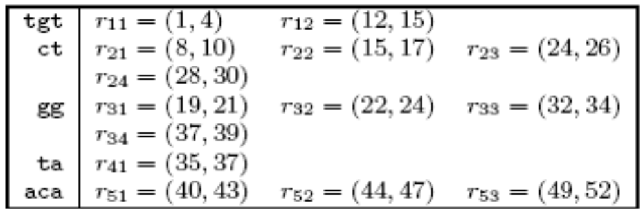
Problem Example-Input
Structured Model :tgt[4,20]ct[2,5]gg[0,1]ta[2,15]aca
String : tgtatcgctggtgtctcaggaggctcgctccgga
taggaacagacagaaca

Slide 4
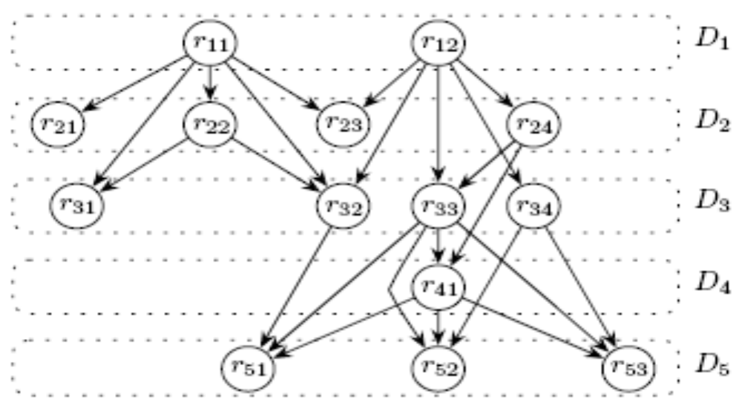
Problem Example-Explicit Graph
Explicit constraint graph of structured model tgt[4,20]ct[2,5]gg[0,1]ta[2,15]aca
with missed pattern at most 1

Slide 5
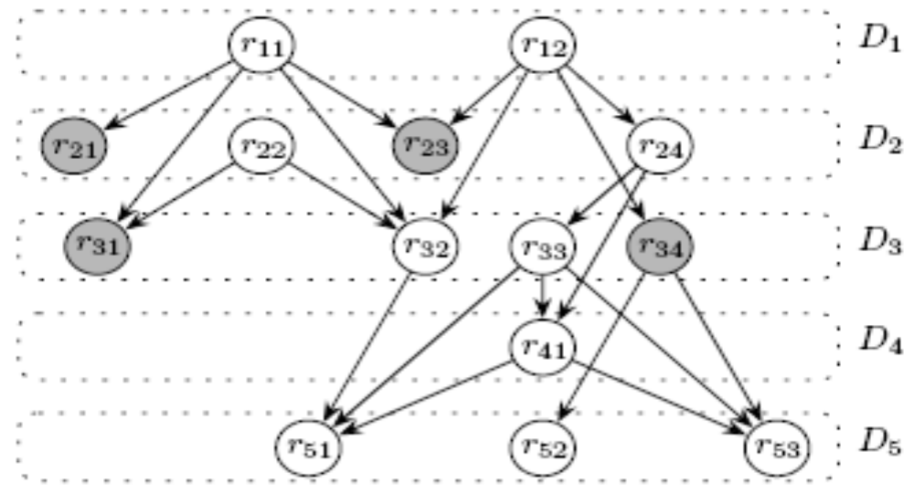
Problem Example-Implicit Graph
implicit constraint graph of structured model tgt[4,20]ct[2,5]gg[0,1]ta[2,15]aca
with missed pattern at most 1

Slide 6
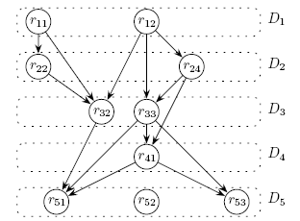
Problem Example(5)

Slide 7
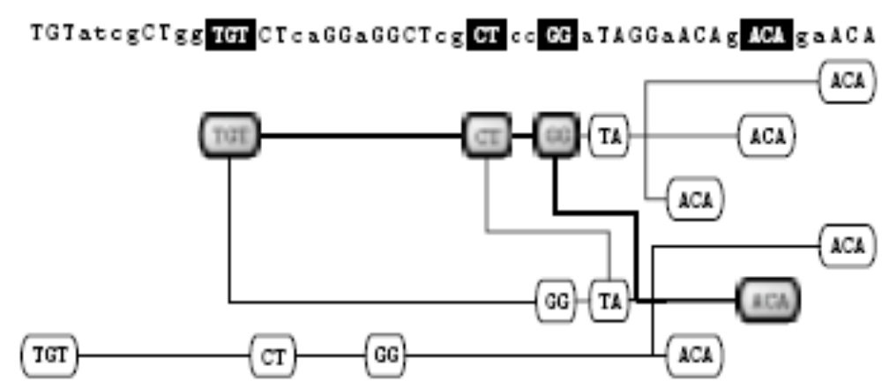
Problem Example(6)-Output Graph

Slide 8
Time Complexity
Construction of the implicit graph : O(M)
Space requirement : O(M)

Slide 9
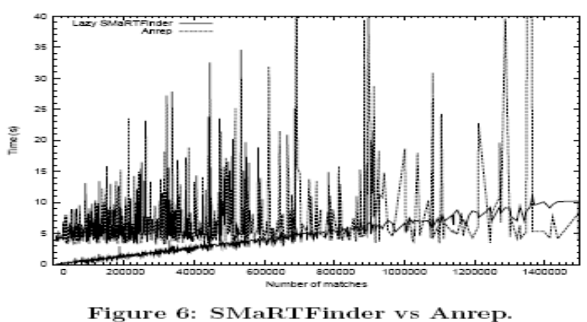
Result Comparison

